Slide 1
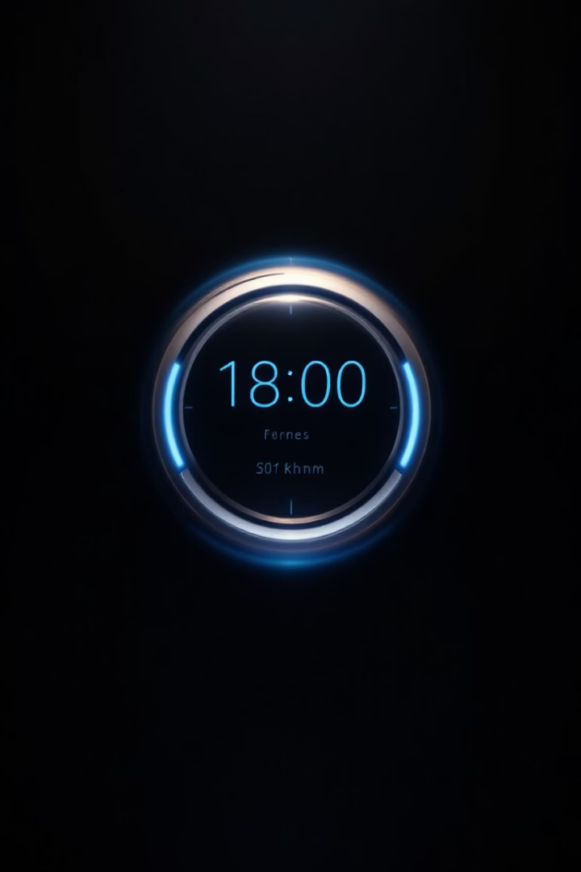
Stopwatch & Clock Application
A versatile time management solution that combines stopwatch functionality with a real-time clock display. Perfect for tracking activities while maintaining awareness of the current time.

Slide 2
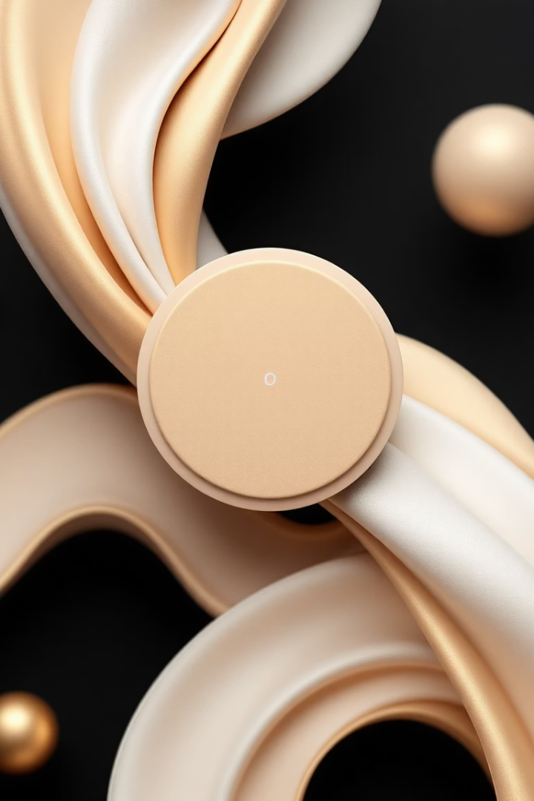


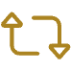
Core Features
Start/Stop Control
Real-Time Display
Reset Function
Clear elapsed time instantly. Start fresh timing sessions with one click.
Begin and pause timing with a single button. Track activities with millisecond precision.
Shows hours, minutes, and seconds. Keeps you aware of current time.

Slide 3
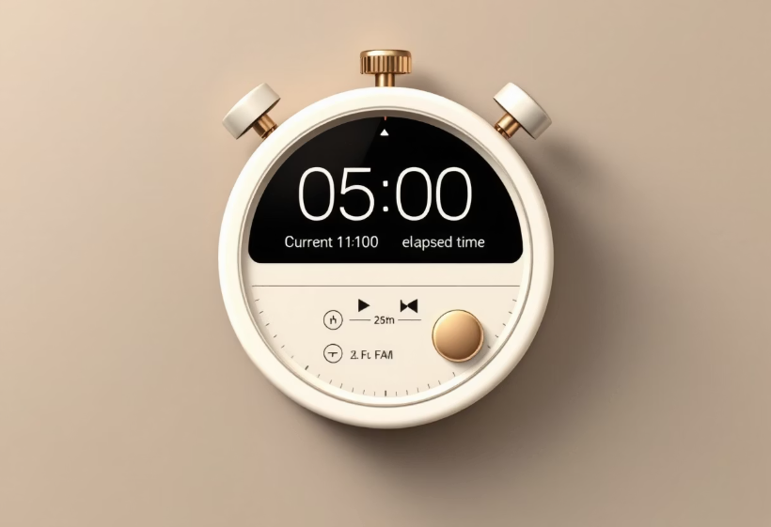
Interface Design & Usability
User-Friendly Layout
The interface features large, easy-to-read digits. Users can quickly see both current and elapsed time.
Button placement follows intuitive patterns. Controls are accessible with minimal learning curve.
Our design prioritizes visibility and ease of use. The high-contrast display works in various lighting conditions.

Slide 4


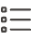


Lap & Split Functionality
Record Lap Time
Mark intermediate times without stopping the main timer.
View Lap History
Access all recorded lap times in a scrollable list.
Compare Intervals
Analyze performance across different time segments.
Save Results
Export timing data for future reference or analysis.

Slide 5
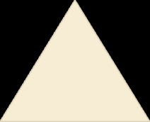

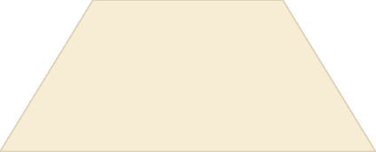

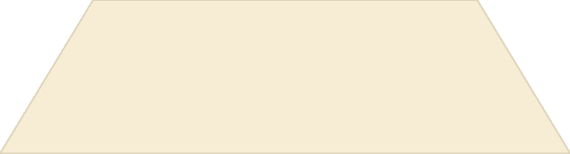
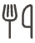
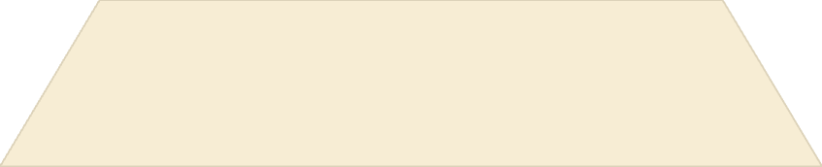

Popular Use Cases
Fitness Training
Track workout intervals and rest periods
Study Sessions
Implement Pomodoro technique with timed work periods
Cooking
Monitor recipe cooking times precisely
Work Productivity
Track time spent on different projects and tasks

Slide 6
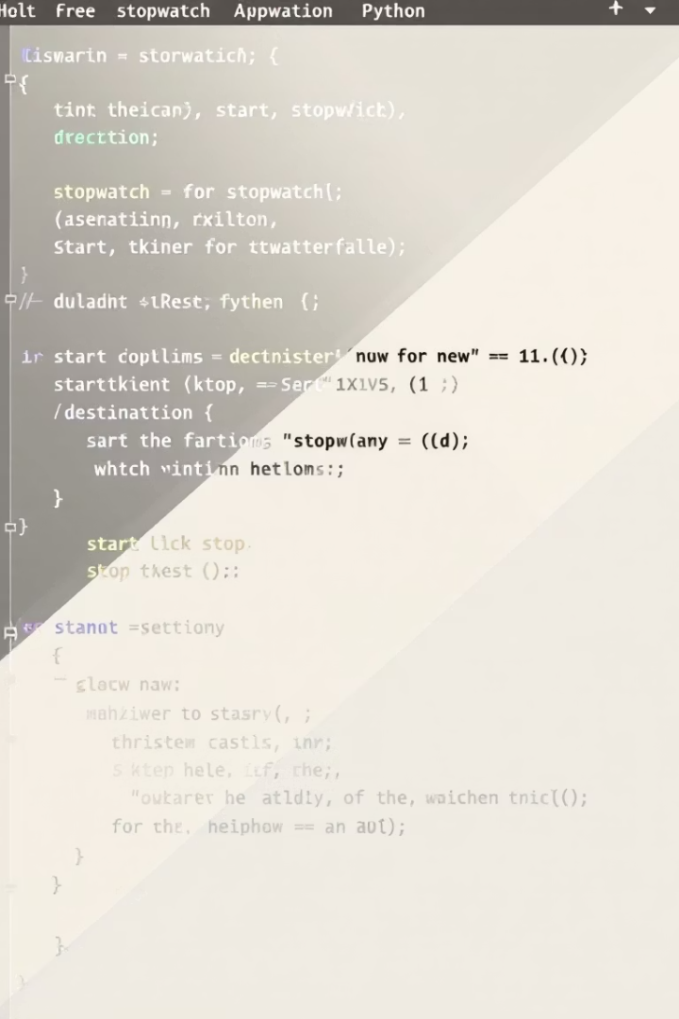
Python Implementation in Jupyter Notebook
Import Required Libraries
Utilize Python's time module for timing functions. Incorporate tkinter for creating the graphical user interface.
Create Event Loop Architecture
Implement an event-driven system. Enable real-time updates of both stopwatch and clock displays.
Build Interactive Controls
Add buttons with clear visual feedback. Enable intuitive user interaction through custom widgets.

Slide 7
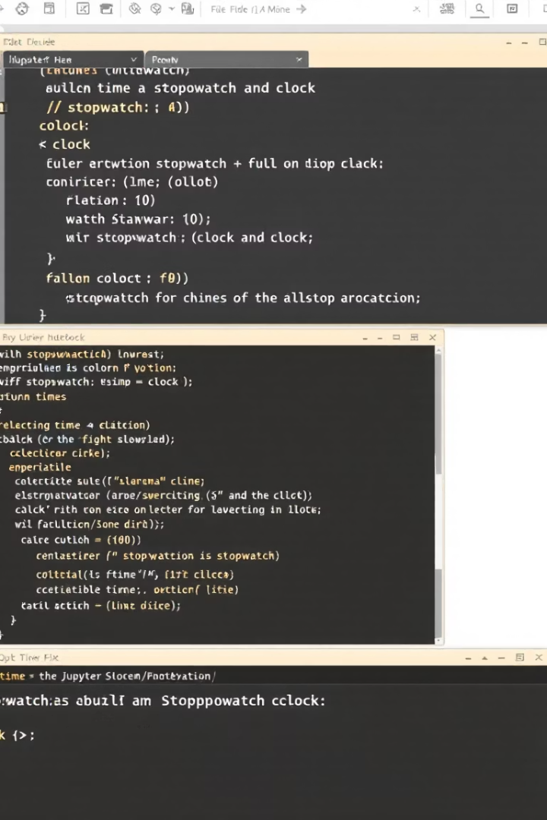
Example Code & Output
Timer Logic
Display Function
def update_time():
current = time.time() - start
timestr.set(format_time(current))
root.after(50, update_time)
def format_time(elapsed):
mins, secs = divmod(int(elapsed), 60)
hours, mins = divmod(mins, 60)
return f"{hours:02d}:{mins:02d}:{secs:02d}"
Button Controls
start_btn = Button(root,
text='Start/Stop',
command=toggle_timer)
reset_btn = Button(root,
text='Reset',
command=reset_timer)

Slide 8
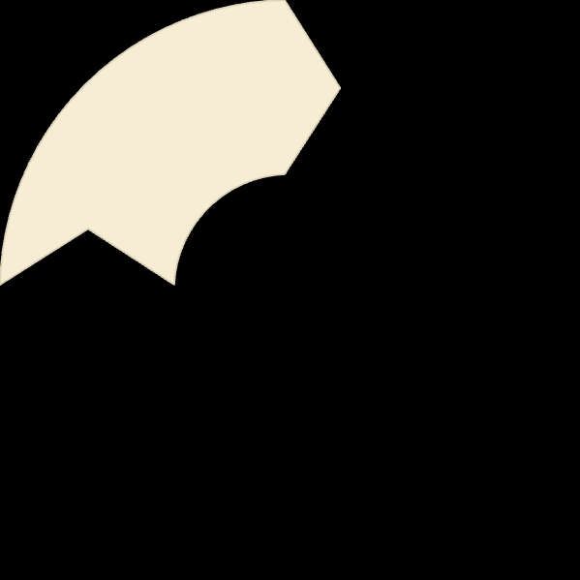
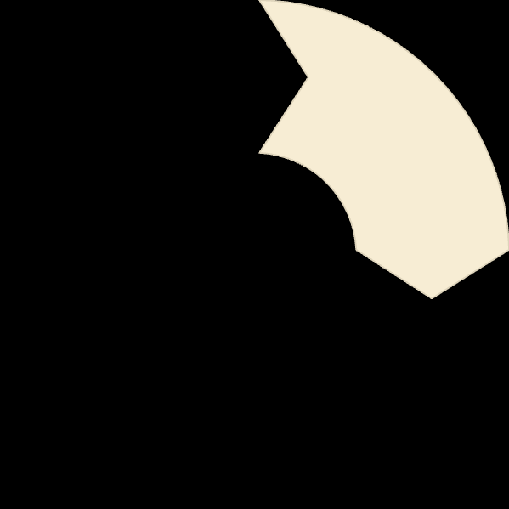
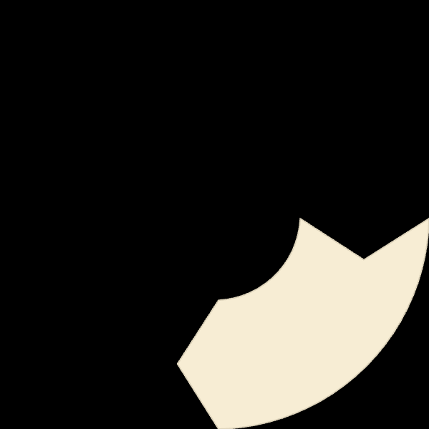




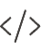
Summary & Advantages
Versatile Timing
Productivity Boost
Combines multiple timing functions in one tool
Helps track and optimize time usage
Python-Powered
Customizable
Built with accessible, powerful programming tools
Easily modified for specific timing needs

